Slide 1
Web Technologies
Internet Fundamentals and Background
MH Zarate
Rivera ECHS

Slide 2
Development of the Internet
Began during the cold war
US Military needed a new method of communication in case of nuclear war.
It had to be reliable.
It could not depend on a central hub.
It would have to continue to function should part of it go down during a nuclear attack.

Slide 3
Development of the Internet
US Department of Defense partnered with a public corporation.
They began work on a prototype of the Internet.
The final prototype was called Arpanet.
Tested by four universities:
Stanford Research Institute
UCLA
University of California at Santa Barbara
University of Utah

Slide 4
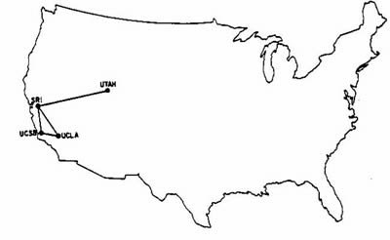
Development of the Internet
Notes:
Map showing the four institutions which made up the Arpanet.

Slide 5
How Information is Transmitted Online
The Internet brought on a very unique method of communicating.
Traditionally information was routed through a central hub where it was directed to its final destination.
Should something happen with the hub, all communication within the network would be halted.

Slide 6
How Information is Transmitted Online
TCP – Transfer Control Protocol
Based on the Arpanet concept
Specifies that information should be broken down into data packets of 1500 characters
IP – Internet Protocol
Specifies that each computer on the Internet should be assigned a unique address
The data packets should contain the sending and receiving computers’ addresses

Slide 7
How Information is Transmitted Online
The Internet does not use a central hub to direct information.
When information is sent from your computer to another computer, the information is sent in multiple data packets which contain both the sending and receiving computers’ IP addresses.
As the packets pass through various computers on the way to its destination, it is sent to the next computer closer to its final destination.

Slide 8
How Information is Transmitted Online
Because each packet has the destination address, the packets do not take the same route to the final destination.
The computer receiving the information keeps track of which packets have been received and notifies the sending computer when all packets have been received.
Should a packet not arrive, the sending computer resends the packet.

Slide 9
How Information is Transmitted Online
TCP/IP specifies how data on the Internet is sent from one computer to another, but there are different types of information that need to be handled differently.
Different types of information should be handled differently and processed by different applications on the sending and receiving computers.

Slide 10
How Information is Transmitted Online
The rules of how information should be handled on the Internet are called protocols.
Web Pages -- http (hypertext transfer protocol)
Email – POP (Post Office Protocol)
File Transfer – FTP (File Transfer Protocol)
Telnet – Terminal connection for direct communication

Slide 11
Early Uses of the Internet
When the Internet first came out, computers were only used by the government, businesses, universities, and the scientific community.
The general public had no interest in computers, much less the Internet.
The Internet was used primarily by the scientific community to share research information.

Slide 12
Early Uses of the Internet
The Internet only allowed researchers to send email and access files for download, which was very inefficient when searching for specific information.
Researchers often had to download hundreds of unnecessary document to their computers.

Slide 13
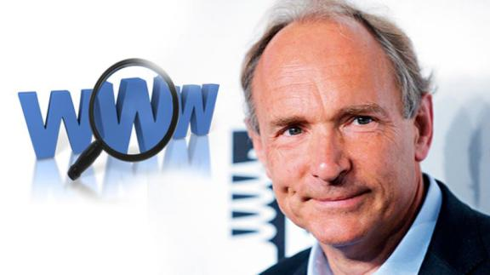
Tim Burners-Lee
Tim Burners-Lee in Geneva, Switzerland.
Tim was trying to come up with a more efficient method of online communication among research institutions without having to download documents to get information.

Slide 14
Tim Burners-Lee
Tim was inspired by the book “Enquire Within Upon Everything” by its vast amounts of random information.
Tim developed a digital notebook to organize and keep track of the online information.

Slide 15
Tim Burners-Lee
This digital notebook allowed for words to be linked directly to other pieces of information.
To achieve this, Tim invented Hyper-Text Markup Language (HTML).
HTML allowed researchers to view and link directly to information without having to download all the files to the computers.

Slide 16
The Internet & the WWW
The Internet itself is the connectivity of computers.
Prior to Tim’s invention of the World Wide Web, there was no formatted text, graphical content; everything was command line driven.
The World Wide Web is the graphical environment that we are all accustomed to working in.

Slide 17
The Browser Showdown!
Research and see if you can find the very first browser made available to the public.
The browser was sold in stores and was the dominate web browser in the beginning.
Can you find out the next browser introduced, creating competition between the two companies?

Slide 18
The Browser Showdown!
Research and find out which company created the first operating system.
With that move, the US Government got involved and attempted to split up the company, separating the operating system and browser.
How did the result of that action help or hurt the first and second companies you researched?
Notes:
AOL eventually bought Netscape.

Slide 19
The Internet Today
15 years ago when you wanted to get connected online, you would connect your phone line to your computer and dial into an internet service provider.
Now the Internet has become integrated into just about every aspect of our lives.

Slide 20
The Internet Today
We use the Internet for more than just surfing web pages on the computer.
Web sites have become so interactive that they have become a huge part of everyday life:
social networking sites;
travel sites;
auction sites;
just to name a few.

Slide 21
The Internet Today
The Internet has moved beyond the computer to our cell phones, TVs, and even home appliances.
The portability of the Internet has spawned many new technologies, such as location based applications that integrate the Internet with GPS.

Slide 22
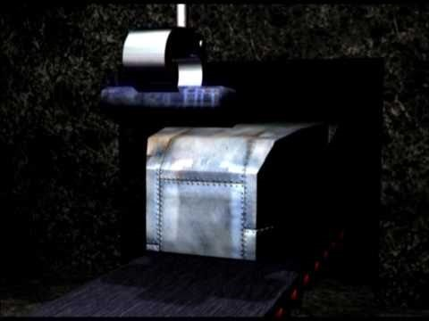
Warriors of the Net

