Slide 1
Digital & Interactive Media
Color Theory

Slide 2
Lesson Objectives
Define terminology related to color theory
Identify types of color schemes
Develop a color scheme
Identify the RGB values for drawing objects
Design a color wheel using RGB values
Establish the CYMK values for drawing objects

Slide 3
PART ONE Color Terminology & Color Schemes

Slide 4
Color Terminology
Color: Color results when light is reflected off of an object. As the light hits an object, some of the light wave is absorbed into the object. A portion of the light wave is reflected back to your eyes.
The color that is reflected is determined by
the LENGTH of the
light wave that is reflected
from the object.

Slide 5
Color Terminology
Primary colors:
Red, Yellow, and Blue
These are considered the basic colors.
All other colors can be created by using a mixture of any of these three colors.
RED
YELLOW
BLUE

Slide 6
Color Terminology
Tints
Created by adding white to a color
Shades
Created by adding black to a color
Blue
White
Blue Tint
+
=
Blue
Black
Blue Shade
+
=

Slide 7
Color Terminology
Secondary colors:
Orange, Violet, and Green
Created by mixing equal amounts of two primary colors
Red
Yellow
=
Orange
+
Red
Blue
=
Violet
+
Blue
Yellow
=
Green
+

Slide 8
Color Terminology
Primary + Secondary = Tertiary
Tertiary colors:
These colors can be created by mixing a primary color with an adjacent secondary color
OR they can be made by mixing unequal amounts of two primary colors.
Yellow
Green
YellowGreen
+
=
Red
+
Violet
Red-Violet
=
Red
+
Orange
=
Red-Orange
Blue
Green
Blue-Green
+
=

Slide 9
Color Terminology
Neutral colors:
White
Brown
Black
Varying shades of each
Black
Gray
White
Tan
Brown

Slide 10
Color Terminology
Color Wheel:
If we arrange the primary, secondary, and tertiary colors in a circle, adjacent to the colors according to their mixture combinations, we get a color wheel.
Blue-Green
Green
Yellow-Green
Blue
Blue-Violet
Yellow
Yellow-Orange
Violet
Orange
Red-Violet
Red
Red-Orange

Slide 11
Color Schemes
Complementary colors:
Any two colors that are exactly opposite on the color wheel
Blue-Green
Green
Yellow-Green
Blue
Blue-Violet
Yellow
Yellow-Orange
Violet
Orange
Red-Violet
Red
Red-Orange

Slide 12
Color Schemes
Split-complement colors:
Has three colors
Pick a color
Find the two adjacent colors of its complementary color
Blue-Green
Green
Yellow-Green
Blue
Yellow
Blue-Violet
Yellow-Orange
Violet
Orange
Red-Violet
Red
Red-Orange
Notes:
If you lay an isosceles triangle in the middle of the color wheel, the tips of the triangle will point to the three split-complementary colors.

Slide 13
Color Schemes
Analogous colors:
Any three colors that are side by side on the color wheel
Blue-Green
Green
Yellow-Green
Blue
Yellow
Blue-Violet
Yellow-Orange
Violet
Orange
Red-Violet
Red
Red-Orange

Slide 14
Color Schemes
Harmonious Pairs:
Has four colors that are split-complements of each other
Find a complementary pair
Locate the two adjacent colors for the original pair
Blue-Green
Green
Yellow-Green
Blue
Yellow
Blue-Violet
Yellow-Orange
Violet
Orange
Red-Violet
Red
Red-Orange
Notes:
If you lay a rectangle in the middle of the color wheel, the tips of it will point to the four harmonious pair colors.

Slide 15
Color Schemes
Triad colors:
3 colors that are equally distant from each other on the color wheel
Most basic triad scheme is the 3 primary colors
If you lay an equilateral triangle (triangle with all three sides the same length) in the middle of the color wheel, the tips of the triangle will point to three colors that make up a triadic scheme.
Blue-Green
Green
Yellow-Green
Blue
Blue-Violet
Yellow
Yellow-Orange
Violet
Orange
Red-Violet
Red
Red-Orange

Slide 16
Color Schemes
Tetrad colors:
Have four colors that are equally distant from each other on the color wheel
If you lay a square in the middle of the color wheel, the tips of it will point to the four colors that make up a tetrad scheme.
Blue-Green
Green
Yellow-Green
Blue
Blue-Violet
Yellow
Yellow-Orange
Violet
Orange
Red-Violet
Red
Red-Orange

Slide 17
Color Scheme Example
Tetrad Pairs
Place a square in the middle of the color wheel.
Your four colors are located at the corners of the square.
Choose two colors for the majority of your objects and let the other two colors be accents.

Slide 18
Color Scheme Example
Analogous Scheme
Choose any 3 colors that are side by side on the color wheel.
Any neutral color may be brought in as an accent.

Slide 19
Assignment #1
Create a color scheme:
Obtain a color wheel.
Using the given printouts and colored pencils (don’t use markers), color in the designs to represent various color schemes.
Choose your own variations of color that represent the given schemes.
Color in all objects within the large, bold rectangle.
You may color in the background with a scheme color, or you may leave it white.

Slide 20
PART TWO Electronic Color & RGB values

Slide 21
Electronic Color
Computer Monitors:
Use light in 3 colors to create images on the screen
Monitors use RED, GREEN, and BLUE color
This is called RGB
Text and object color are determined by its RGB values
Blue
Green
Red

Slide 22
Electronic Color
Setting RGB values:
Click on the Shape Fill button
Choose the More Fill Colors option
Click on the Custom tab

Slide 23
Electronic Color
Setting RGB values:
A color is defined by three values
These values must be within the number range 0-255
Blue is created by a Blue value of 255; Red and Green values are 0
Equal values of Red and Green create Yellow

Slide 24
Electronic Color
Setting RGB values:
When all values are 0, it creates black
When all values are 255, it creates white

Slide 25
Assignment #2
Create a color wheel:
Create drawing objects and fill them with color by changing the RGB values.
Move and rotate the objects to create a color wheel.
There should be 4 color variations between each primary and secondary color.

Slide 26
PART THREE Printed Color & CMYK values

Slide 27
Pigment Color
Color Printers:
Use mixtures of 4 colors
Printers use CYAN, MAGENTA, YELLOW, and BLACK color
This is called CMYK
Cyan
Magenta
Yellow
Black

Slide 28
Pigment Color
Color Printers:
Combinations of CMYK will create Blue, Red, or Green
The monitor screen displays color in RGB values; the printer will print that color in CMYK values.
Sometimes, the translation causes the color on a printout to be different than that on the screen
Magenta
Cyan
Blue
+
=
Magenta
Yellow
Red
+
=
Yellow
Cyan
Green
+
=

Slide 29
Pigment Color
Setting CMYK values:
In some programs, you can switch the color mode from RGB to CMYK

Slide 30
Pigment Color
Setting CMYK values:
A color is defined by four values
These values must be within the number range 0-100
You can achieve the same color selection as RGB but using CMYK values instead
The color Blue
in RGB values is 0, 0, 255
In CMYK values is 99, 67, 0, 20
Notes:
The RGB value of the color Blue is 0 0 255
The CMYK value of the same color Blue is 90 67 0 20

Slide 31
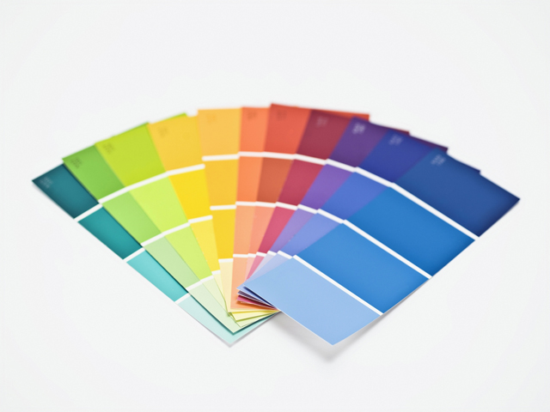
Assignment #3
Create a paint strip:
Using a software program that allows CMYK values, recreate the color scheme of a paint chip sample.
Print the document, then record the RGB values and CMYK values for each color.
Print the document in color.
Staple the paint chip sample to the document.

Slide 32
The End

