Slide 1
Web Technologies
Website Planning and Design

Slide 2
Determining Client’s Needs
As a web designer, you should never assume you know what your client wants.
Before starting any web project, you should meet with the clients to determine exactly what they want to get from their website, and what information they want it to provide.
During the client meeting, a Quality Assurance Plan should be completed.
Notes:
Discuss with the students how the overall mission for a website is different for each type of business, and why it is important -- before any website project is started -- to clearly define the purpose and objectives of that website

Slide 3
Quality Assurance Plan
There are not any specific guidelines for developing a Quality Assurance Plan. It should, however, consist of at least four parts outlining how the site is to be designed in order to meet the specific needs of the client.
The Quality Assurance Plan should be referred to and updated throughout the design process.
Notes:
Explain that the job of the website designer is to create a site that achieves each of the goals the business sets for its website.

Slide 4
Quality Assurance Plan
The Quality Assurance Plan should consist of four detailed documents:
Client Needs Assessment
Development Plan
Test & Revision Plan
Final Review Procedures

Slide 5
Client Needs Assessment
The designer should complete the Needs Assessment during a meeting with the client.
It should clearly state what the client wants to achieve with the site.
What features does the client want on the site? Document all required design qualities.
Discuss a targeted completion time along with established milestone points.

Slide 6
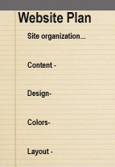
Development Plan
The Development Plan should describe in detail how the site is to be designed.
Site organization
Content to be included
Page Design
Layout of content on pages
Color schemes
Navigation
Any other vital details of site development
Completion milestones

Slide 7
Test & Revision Plan
Ultimately, the Test & Revision Plan should determine if the design of the site is satisfying the goals of the site. It also serves to keep the client involved in the design process.
This phase should include a meeting with the client.
The designer should identify any errors or problems in the design and formulate solutions to present to the client.

Slide 8
Final Review Procedures
Upon completion of the site, the designer should present the site to the client for final review.
The designer should have the client sign off on each of the design objectives defined in the Development Plan as well as the final version of the site.

Slide 9
Content Layout
The main thing to consider when planning the layout of your pages is readability for the viewer.
The content should be placed in such a way that the visitor can easily read what is on the page -- and quickly find where to go to move on.
The organization and layout should also be visually appealing, known as aesthetics.

Slide 10
Content Layout
There are a few simple rules to remember when placing content on the page:
Navigation
Most people are accustomed to looking at the top or left side of their screen for the site navigation.
Main Areas of Content
The primary content area should generally be placed in the center of the screen. This is where most people are going to look first.

Slide 11
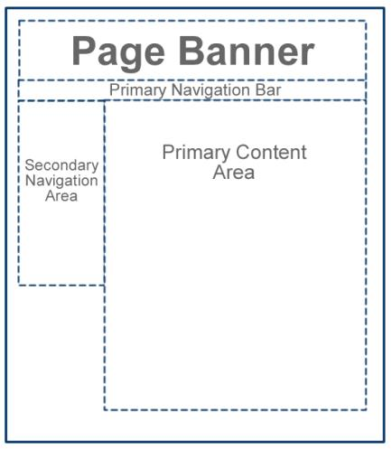
Content Layout
The sample layout here shows one possible way content could be organized using the sections described.

Slide 12
Content Layout
Rules (continued)
Sub-Sections
You may want to include subsections, such as areas with less importance.
Subsections can be placed around the primary content. Sub content will often include advertisements or related news items that the visitor can click on for additional information.

Slide 13
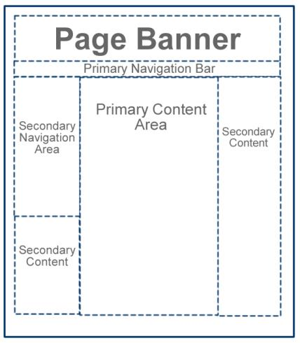
Content Layout
The example here shows a layout with secondary, or sub-content placed around the primary content.

Slide 14
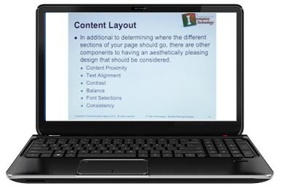
Content Layout
In addition to determining where the different sections of your page should go, you should consider other components to having an aesthetically pleasing design.
Content Proximity
Text Alignment
Contrast
Balance
Font Selections
Consistency

Slide 15
Content Proximity
Content Proximity refers to placing similar content together.
For example, it will be easier for the visitor to make connections with similar content -- such as a picture -- if the picture is physically placed closer to the text that it refers to.
The same would hold true for any diagrams, lists, or any other page content.

Slide 16
Text Alignment
You have the ability to align text in many different ways, but that does not mean you should!

Slide 17
Text Alignment
Headings & Titles
You have more flexibility when aligning headings and titles to content. Any of the alignment methods except justify is generally acceptable.
Paragraph Content
The larger amounts of text (such as your primary and secondary content) should be left aligned or justified.
Most people find it awkward to read paragraphs that are centered or right aligned.

Slide 18
Contrast
Contrast refers to the degree of difference, particularly in web design, between the background and the content.
Most people find it easier to read dark text on a light background.
Keeping with a dark background and light text or dark text on a light background ensures plenty of contrast and easy readability.

Slide 19
Contrast
Some artistic designers like to put more emphasis on the artistic design of the site and use one color for the background and a different shade of the same color for the text.
While this may look nice, the ability of the visitor to easily read the content should be the first priority.
Poor Contrast
Good
Contrast

Slide 20
Balance
When placing your content on your page, you must space content out so it is evenly distributed.
You do not want one side or part of your page to look full while another side looks empty.
Generally, photos are considered to be “heavier” than text when balancing content.
Achieving balance by evenly distributing content will give your website a more professional appearance.

Slide 21
Font Selections
Many new website designers make the mistake of using fancy or nontraditional fonts.
Web pages can only display fonts that are installed on the visitors’ computers.
If you use a fancy font on your website, chances are none of your visitors will see it.
It is generally best to stick with the Times New Roman or Arial fonts, or the generic Serif or Sans Serif fonts.

Slide 22
Consistency
Finally, even though it seems boring, you should make all your pages look the same.
All your pages should have the exact same “look and feel”
Same layout, color choices, font selections, navigation, etc.
Consistency brings all your pages together and makes them appear to belong together.

