Slide 1
Digital and Interactive Media
Emerging Technologies

Slide 2
Technology and DIM
What kinds of technology impact the way Digital Interactive Media is created and presented to the public?
Computers
Software
Digital Still/Video cameras
Scanners

Slide 3
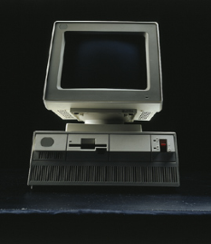
Technology and DIM
Computers:
Then Now

Slide 4
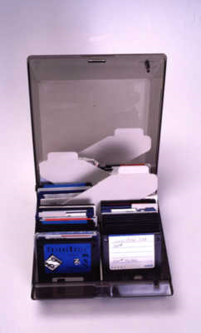
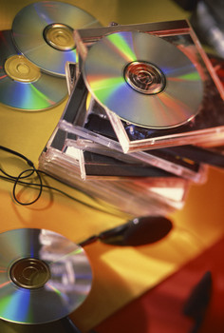
Technology and DIM
Software:
Then Now

Slide 5
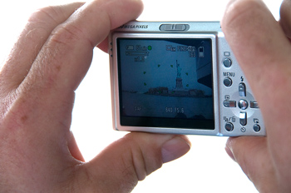
Technology and DIM
Digital Still/Video cameras:
Then Now

Slide 6
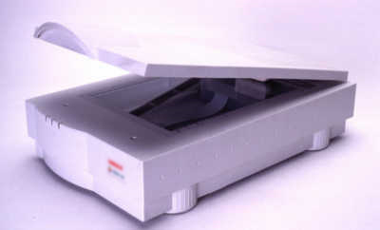
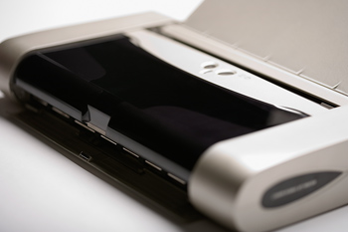
Technology and DIM
Scanners:
Then Now

Slide 7
Technology and DIM
How has it impacted the industry?
DIY mentality
I can do it myself
I don’t need to pay to have it done.
Financial impact
Is it cheaper now?
Creative impact
What can we do now that we couldn’t do before?

Slide 8
Technology and DIM
What are the “Newest” pieces of technology?
What does it do?
Was there anything like it before?
What has it changed?
Will the change be better or worse for DIM?
Monetary impact
How can we use it to our advantage?

Slide 9
Technology and DIM
What will come next?
Ideas?
How might they impact the industry?

