Slide 1
Chapter 4
Digital Photography
© 2017 Cengage Learning®. May not be scanned, copied or duplicated, or posted to a publicly accessible website, in whole or in part.

Slide 2
Lessons
Lesson 4.1: Reviewing Cameras
Lesson 4.2: Taking Photographs
Lesson 4.3: Adjusting Settings

Slide 3
Learning Outcomes
4.1: Demonstrate knowledge of camera basics
4.2: Transfer images from a digital camera to a computer
4.3: Use good composition skills to take photographs
4.4: Photograph images with several different techniques
4.5: Use camera settings to modify an image
4.6: Adjust camera’s white balance to improve an image

Slide 4
DSLR Versus Point and Shoot
Digital cameras fall into two basic categories:
DSLR (digital single lens reflex)—a camera that uses a mirror system to capture an image
Point and shoot—a camera designed to be easy to use with preset functions
DSLR cameras are for professional or serious amateur photographers most interested in image quality
Point-and-shoot cameras are for photographers who want ease of use and convenience

Slide 5
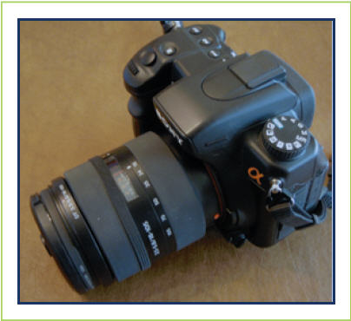
DSLR Versus Point and Shoot (cont.)
DSLR cameras:
Better image quality
More adaptability
Faster performance
More manual control
WYSIWYG
Susan Lake

Slide 6
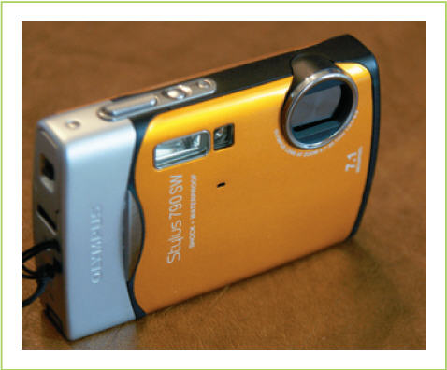
DSLR Versus Point and Shoot (cont.)
Point-and-shoot cameras
Less expensive
More portable
Easier to use
Susan Lake

Slide 7
Camera Features
Shooting modes
A jog (or mode) dial is a type of wheel or dial on a camera that makes is possible to scroll through setting options by rotating the dial
Camera, tulip & mountain icons: Ritu Manoj Jethani/ Shutterstock.com; manual icon: Cengage Learning

Slide 8
Camera Features (cont.)
Megapixels
A unit of measure equal to 1 million pixels
On a digital camera, the megapixels on an image sensor react to and record light to produce an image
The number of megapixels indicates the maximum image resolution of a camera

Slide 9
Camera Features (cont.)
Optical versus digital zoom
With optical zoom, the camera lens physically moves to magnify your subject and make it appear closer
With digital zoom, the digital image sensor crops the area around your subject and digitally enlarges the subject (through interpolation of pixels) to fill the frame

Slide 10
Camera Features (cont.)
File types
The default file format for most digital cameras is JPEG (.jpg)
Some professional or serious amateur photographers prefer cameras that can save an image in a raw file format
Raw files
Include all of the image data without any compression or processing
Must be processed by the photographer using conversion software on a computer

Slide 11
Camera Care and Safety
Camera care
Keep the lens area clean by using a soft lens cloth
Keep the lens cap on or the shutter closed when not using the camera
Beware of dropping the camera even from a short distance
Never force a memory card in or pull it out if there is resistance
Never force an uncooperative switch; instead find out why the latch or door is unable to function
Never throw rechargeable camera batteries in the trash: they can leak toxins into the environment

Slide 12
Camera Care and Safety (cont.)
Camera safety
Don’t shoot directly into the sun
Don’t walk while looking through the viewfinder
Don’t store camera batteries where they can come in contact with one another
Don’t handle batteries that appear to be leaking
Don’t open a camera body; some components can deliver an electrical shock

Slide 13
Taking Photographs
Candid photographs— unplanned photographs taken with little or no preparation or posing
Photographic composition—selection and arrangement of design elements within a photograph
Elements of design include line, shape, color, and lighting
Principles of composition include unity, balance, perspective, and emphasis

Slide 14
Focal Point
A focal point is the most important element within an image on which you want a viewer to focus
Use simple principles of composition to organize other elements in the image to direct your viewer’s attention to the focal point of the image

Slide 15
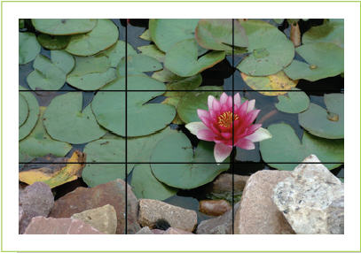
Rule of Thirds
The rule of thirds states that an image should be divided into an imaginary grid of nine equal parts and that the focal point should be placed at or close to the point where the lines of the grid intersect
Susan Lake

Slide 16
Framing
Framing is using elements in a scene to visually surround your subject and make it stand out
One key to framing is to make sure that the frame does not draw too much attention to itself; the objective is to focus on the subject
Susan Lake

Slide 17
Leading Lines
Leading lines are actual or suggested lines in an image that draw a viewer’s eye through an image in a specific direction, usually to the focal point
Lines can be straight, curved, vertical, horizontal, or even diagonal
Susan Lake

Slide 18
Cropping
Cropping in photo composition means including all the elements you want and excluding anything you don’t want
Remove unnecessary clutter in the background or surrounding your subject that will distract from your focal point
Fill the frame, eliminating unwanted elements, and allowing the subject to occupy more space

Slide 19
Directional Lighting
Front lighting comes from behind the camera and illuminates the front of the subject, producing few or no shadows
In side lighting, light is directed at a subject from either the left or the right side, creating lots of shadows and highlights
Photos from Shutterstock.com - rocks: JFulmer; flower: hjschneider

Slide 20
Directional Lighting (cont.)
In back lighting, the light shines from behind the subject, toward the camera
Shape and outline of a subject are emphasized, but other details are mostly lost in shadow
Photo from Shutterstock.com: Kondrashov Mikhail Evgenevich

Slide 21
Depth
Clues the brain uses to perceive an object as three-dimensional:
The contrast between light and shadow
The size and relative position of items, or perspective
Cameras take three-dimensional scenes and record them on the two-dimensional surface of a photograph
There is no third dimension of actual depth in a photograph; the brain uses the same visual clues in a photograph to perceive the illusion of depth

Slide 22
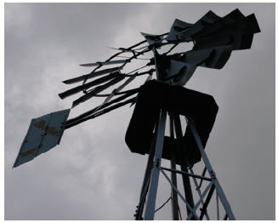
Depth (cont.)
Perspective
In photography, what makes items look larger and closer or smaller and farther away
Can be used to create depth and express a story about a subject
Angles
Shooting from a low angle makes subjects appear bigger and more important
Shooting from a higher angle diminishes a subject
Elena Elisseva/Shutterstock.com
Susan Lake

Slide 23
Depth (cont.)
Foreground, middle ground, background
To create depth in your photos, make sure you have:
Background
Middle ground
Foreground
Add depth by adding another element in front of your main subject
© Dmitriy Shironosov/Shutterstock.com

Slide 24
Film Manufacturers
The rise of digital photography means challenges for film manufacturers such as Kodak, Fuji, and Polaroid
How did these businesses each respond to these challenges and what was the outcome?
What can other industries learn about being ready for technological advances?

Slide 25
Adjusting Settings—Basics
Three components that a camera uses to capture an image:
Shutter speed (how fast the lens opens and closes)
Aperture settings (how wide the lens opens to let in light)
ISO (speed at which the “film” captures an image)
Many cameras provide pre-set special image types such as a macro (close-up) setting, a distance setting, or a sports setting

Slide 26
Basics (cont.)
Shutter speed
Adjust to achieve specific and desired effects
Aperture
Changing the aperture settings determines the depth of field
Measured in f-numbers (often referred to as f-stop or f-ratio)
ISO
Low ISO settings capture an image sharply with few extra pixels or graininess
High ISO settings work hard to capture an image in low light but the result is an image that has artifacts

Slide 27
White Balance
Light has various color temperatures (measured in Kelvins)
White balance means that the camera attempts to make white look truly white without the yellowness of a candle or the blue of an overcast day

Slide 28
Maintaining Perspective
What are some common challenges faced by people who work in multimedia-related fields?
Which of these would you classify as serious problems?
Which are simply minor annoyances?

Slide 29
Key Concepts
Digital cameras fall into two categories: point and shoot and DSLR
Some people choose DSLR cameras for high image quality, more adaptability, faster performance, and more manual control
Point-and-shoot cameras are generally less expensive, less bulky, and easier to use than DSLR cameras

Slide 30
Key Concepts (cont.)
A wide range of shooting modes on a point-and-shoot camera can help you take better pictures in a bigger variety of situations
Cameras measure the possible image size by using megapixels
In optical zoom, the camera lens actually moves to magnify a subject; in digital zoom, the image processor crops the area around the subject and uses interpolation to make it appear bigger

Slide 31
Key Concepts (cont.)
Most digital cameras save images as JPGs, which are relatively small and easy to use in a variety of settings, but use lossy compression
Some cameras offer a raw data file option, which is stable and offers more control over settings, but must be converted before images are editable and usable
Digital cameras must be treated carefully to prevent damage and maintain safety

Slide 32
Key Concepts (cont.)
Photographic composition requires the photographer to consider the focal point, the rule of thirds, framing, leading lines, and depth
Shutter speed, aperture, and ISO determine the way a photograph is captured

