Slide 1
Chapter 10
Print Design
© 2017 Cengage Learning®. May not be scanned, copied or duplicated, or posted to a publicly accessible website, in whole or in part.

Slide 2
Lessons
Lesson 10.1: Understanding Design Principles
Lesson 10.2: Structuring a Layout
Lesson 10.3: Using PDFs for Print Publications

Slide 3
Learning Outcomes
10.1: Recognize basic design principles: balance, rhythm, emphasis, and unity
10.2: Understand the role of white space
10.3: Follow preliminary steps to plan a layout
10.4: Set up a new document in desktop publishing software
10.5: Use a grid to lend underlying structure to designs
10.6: Understand why PDFs are important in the print publication process

Slide 4
Understanding Design Principles
Layout is the arrangement on a page of all the key parts without regard to the specific content
Design principles such as balance, rhythm, emphasis, and unity make a layout effective
A pica is a printer’s measurement equal to 1/6 of an inch
A point is a division of a pica
There are 12 points to a pica

Slide 5
Understanding Design Principles (cont.)
The overriding idea behind good design is the relationship between similarity and contrast
Similarity in a design helps a viewer navigate and recognize a design as a single unit
Without similarity, a design is chaotic and the message is not clear
Contrast in a design captures, keeps, and directs a viewer’s attention
Without contrast, a design can be boring and, potentially, ignored

Slide 6
Balance
Balance—a design principle in which the weight of elements is distributed in a visually appealing way
Unbalanced designs can leave a viewer feeling uneasy
To achieve balance, a designer must arrange graphic elements so that all sides of the layout have the same visual weight
There are three types of balance: symmetrical, radial, and asymmetrical

Slide 7
Balance (cont.)
Symmetrical balance—elements are distributed equally on both sides of an axis and may be mirror images of one another
Radial balance—elements radiate out from a center point, like a starburst

Slide 8
Balance (cont.)
Asymmetrical balance— the elements on either side of the imaginary axis are not equal or mirrored, but they carry the same visual weight

Slide 9
Rhythm
Rhythm—a design principle that connects elements in a design and guides the eye from one item to the next
Rhythm normally shows up in one of three forms:
Regular: The fixed, even pattern of elements that suggests faster movement
Flowing: A softer, more subtle repetition of elements, often involving curves and rounded patterns, that suggests a slower movement
Progressive: A more rare form of repetition in which an element is depicted in various stages of progress that suggests movement through time

Slide 10
Rhythm (cont.)
Does this design incorporate rhythm?
What elements indicate the rhythm?
What could be changed to use rhythm more effectively in this example?

Slide 11
Emphasis
Emphasis—a design principle in which certain elements in a design stand out more than others
Three basic ways to establish emphasis in a design: placement, isolation, and contrast
Designers achieve emphasis by contrasting the properties of certain design elements:
Size
Shape
Color
Orientation

Slide 12
Unity
Unity—a design principle that pulls together elements to make the design look like a single unit
Four general areas contribute to unity in a design:
Proximity
Alignment
Repetition or consistency
Contrast
Notice that the pen is just slightly out of alignment. Does your eye want to straighten it?

Slide 13
White Space
White space—the areas in which text or graphics do not appear
A block of white space can be used as a means of guiding the eye, as well as of resting it
White space can pose two problems:
It can be trapped when surrounded on all sides by text or graphics
It can display as rivers of white in text

Slide 14
Structuring a Layout
Preliminary work before even launching your software:
Gather materials
Brainstorm a design theme
Choose design elements
Sketch layout ideas

Slide 15
Setting Up a New Document
When you create a new document, you must specify certain page setup options that will be applied to all of the pages
Use a dialog box like the one at right to specify document settings

Slide 16
Setting Up a New Document (cont.)
Page setup decisions include choosing:
Facing pages: Two side-by-side pages; also referred to as a spread
Number of pages: Multipage documents sent to a professional printer must be set up in even signatures
Number of columns: Columns are nonprinting guidelines used to organize and align elements on the page
Size of gutters: A gutter is the white space between each pair of columns

Slide 17
Setting Up a New Document (cont.)
Page setup decisions include (cont.):
Margins
Wide margins can make a design cleaner, but mean less content can fit on a page or spread
Narrow margins mean more content on a page, but can make a page look crowded and chaotic
Bleed: A bleed is an element that extends through the margin of a page right up to the edge

Slide 18
Using a Grid to Organize Elements
Grid—a series of vertical and horizontal non-printing guidelines that direct placement and size of objects on a page
A grid can make it easier to incorporate design principles

Slide 19
Using a Grid to Organize Elements (cont.)
The series of vertical grid lines in a layout are referred to as columns
The appropriate number of columns for a design will depend on the size of the page and the complexity of the design

Slide 20
Using a Grid to Organize Elements (cont.)
General guidelines for determining the number of columns for a project:
Two-column grids are useful for narrow pages and simple designs
Three-column grids are more flexible since items can span one, two, or all three columns
Four or more columns are usually the most flexible choice for page structure
Odd numbers of columns seem to work best in a design because they allow you to build asymmetry

Slide 21
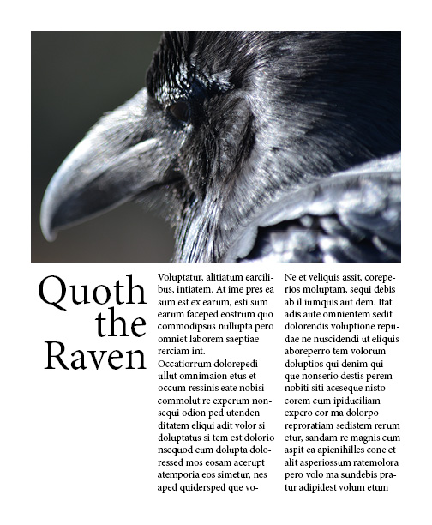
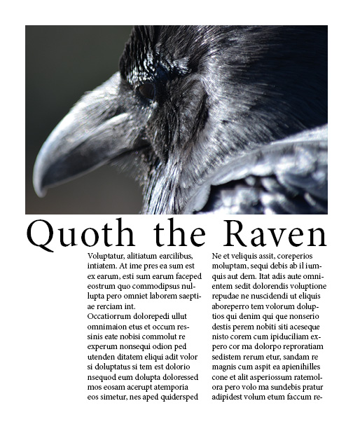
Using a Grid to Organize Elements (cont.)
What is the underlying column structure in these layouts?
Edward Skintik

Slide 22
Using a Grid to Organize Elements (cont.)
The vertical alignment of elements is the most important concern in design
Horizontal alignment is determined by how big an element is after you size it to fit the vertical columns
Alignment is important for establishing order in a design, but just as important is occasionally breaking the order to create interest
When breaking the grid, do it for a specific reason: to achieve unity, balance, emphasis, or rhythm

Slide 23
Master Pages and Templates
Master pages can be applied to any page within a document
Usually include elements repeated on multiple pages
Can contain a basic structure that will be repeated on multiple pages
Are useful shortcuts for standardizing designs across any document series that shares common elements
Master pages are often incorporated into templates

Slide 24
Creating and Viewing PDFs
You will most likely generate PDFs directly from within your layout program
There are two basic tasks associated with PDFs: creating PDFs and viewing them
Some PDF software can both create and display PDFs
Other software can display PDFs, but cannot create them

Slide 25
PDFs and Print Production
When you send a PDF of your document to a printer, you can be confident that what you saw in the PDF is what will come off the press
You can create a PDF for the press from almost any application
It’s best to create PDFs using settings verified or supplied by the print vendor
PDF/X minimizes the chance of problems once your PDFs reach the press

Slide 26
Flexibility and Adaptability
Being able to manage and resolve conflict is an important job skill
To manage conflict:
Show respect and understanding for others
Offer alternatives
Avoid stereotyping and offensive or condescending language
Use intervention, confrontation, and compromise

Slide 27
Key Concepts
An overriding idea behind good design is the tension between similarity and contrast:
Without similarity, a design is chaotic and unreadable
Without contrast, a design is boring and forgettable
Balance is the design principle that says the weight of objects is evenly distributed across a design
In symmetrical balance, elements are distributed equally on both sides of the axis

Slide 28
Key Concepts (cont.)
In asymmetrical balance, the elements on either side of the imaginary axis are not equal or mirrored, but they carry the same visual weight
Rhythm refers to how a viewer’s eye travels through a design and is often established through repetition of a design element or sequence
Emphasis relates to the center of interest in a design and establishes a visual hierarchy that leads a viewer through a layout

Slide 29
Key Concepts (cont.)
Emphasis is often established through placement, isolation, and/or contrast of design elements
Unity in a design means that all of the individual elements of a design look like they belong together and cause the reader to recognize the design as a whole before noticing its individual parts
Proximity, alignment, and repetition (especially in alignment and structure) contribute to unity in a design

Slide 30
Key Concepts (cont.)
Using a grid reduces the randomness of deciding where to place items on a blank page and how big to make them
The grid is important for establishing order in a design, but just as important is occasionally breaking the order to create interest

Slide 31
Key Concepts (cont.)
Master pages and templates are shortcuts for creating consistent documents that share a similar design and features
PDFs are well suited for the print publication process because they retain all of the data about fonts, graphics, color, and so on from the native application file and minimize issues on the press

